Slide 1
Murat Akova, M.D.
President, ESCMID

Slide 2
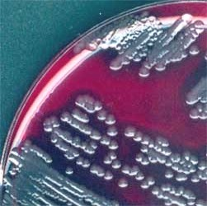
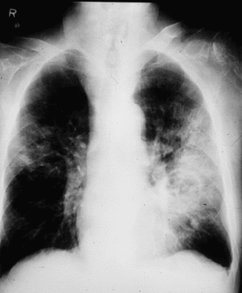
Two partners working in cooperation
Clinical Microbiologists
Infectious Disease Specialists

Slide 3
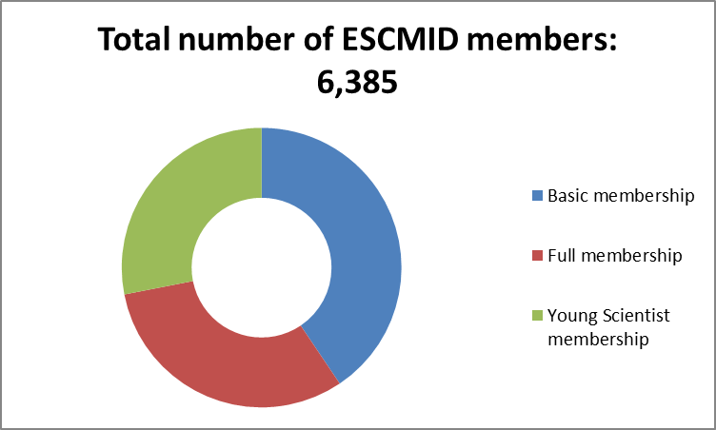
Membership

Slide 4
ESCMID Executive Members
Svenska presidenter: Carl-Erik Nord, Ragnar Norrby, Gunnar Kahlmeter
Murat Akova, ID President (2016)
Mario Poljak, CM Secretary General & President Elect
Gunnar Kahlmeter, CM Past President & Communications 2002 - 2016 Officer
Cornelia Lass-Flörl, CM Treasurer
Annelies Zinkernagel, ID Scientific Affairs Officer
Jesús Rodriguez Baño, ID Education Officer
Evelina Tacconelli, ID Professional Affairs Officer

Slide 5
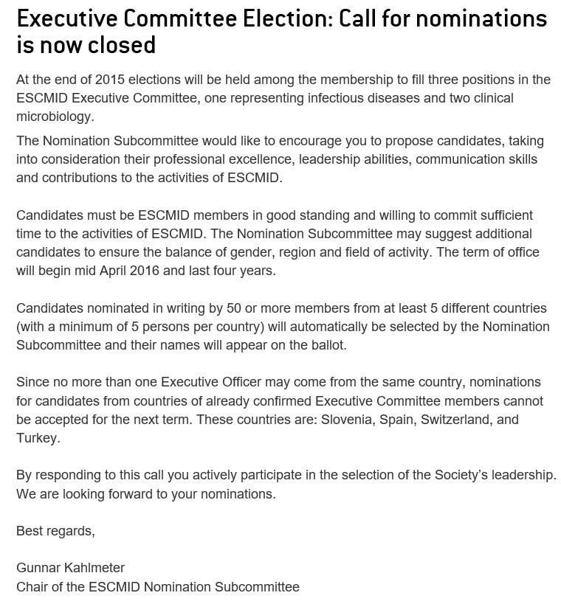

Slide 6
ESCMID Executive Office – in Basel
Judith Zimmermann
Executive Director
Chantal Britt Communications Manager
Thomas Greif Education Manager
Milena Griffiths Finance & Administration Manager
Nora Nedkov Project Manager Events
Henri Saenz Science Manager
Dianne White Professional Affairs & Membership Manager

Slide 7
About ESCMID

Slide 8
Barcelona

Slide 10
Number of Participants
10,671

Slide 11
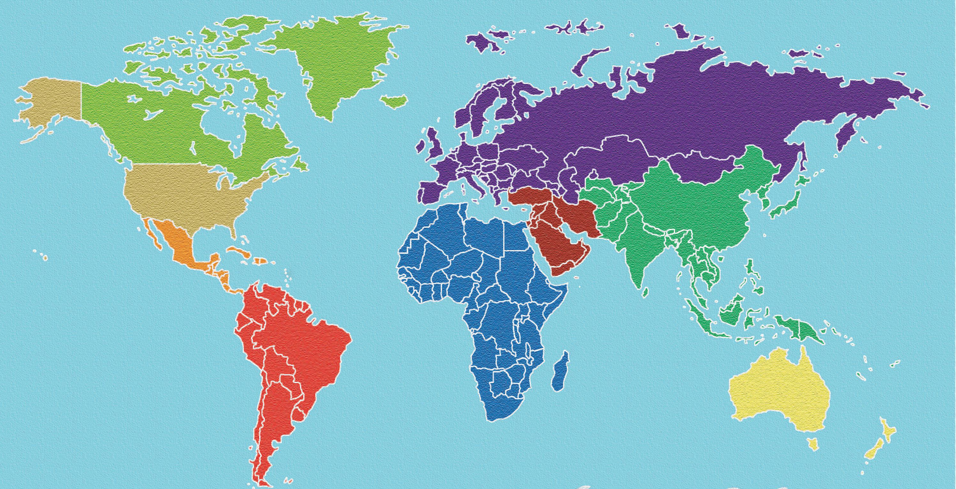
Number of Countries Participating
112

Slide 12
Top 10 Countries
112
1 | USA
2 | United Kingdom
3 | Germany
4 | Spain
5 | France
6 | Italy
7 | Denmark
8 | Netherlands
9 | Switzerland
10 | Sweden

Slide 13
Abstracts

Slide 14
Faculty

Slide 15
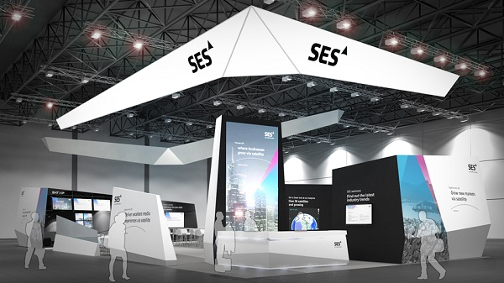
Exhibition
165 exhibitors; 4543 m² (net) area

Slide 16
Istanbul
Amsterdam

Slide 19
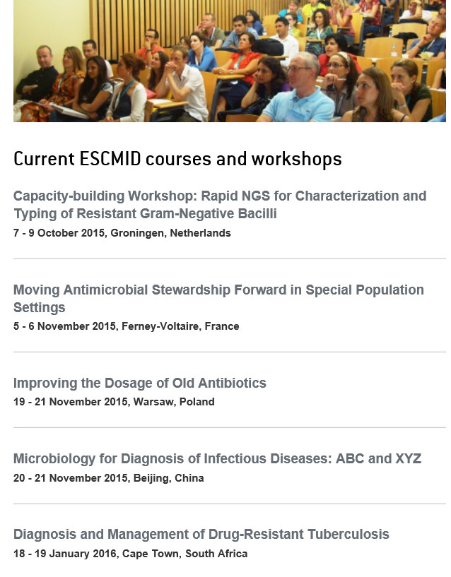

Slide 21
Online Lecture Library

Slide 22
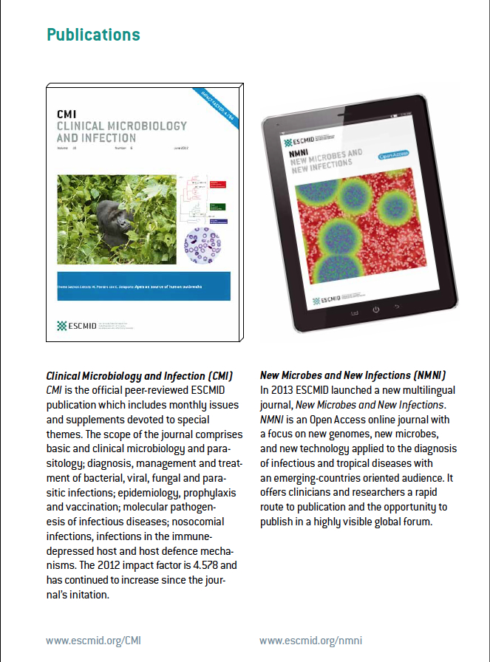

Slide 24
Forensic and Postmortem Microbiology www.escmid.org/esgfor
New Study Group
First plans:
Establish European guidance for standardized sampling in forensic microbiology
Publish such European guidance
Set up study group project: interpretation of microbiological samples from forensic cases
Notes:
Ask ESGLI for slides

Slide 25
Veterinary Microbiology www.escmid.org/esgvm
New Study Group
First plans:
Joint strategy meeting at ECCMID 2015 in collaboration with VetCAST Educational workshops and symposia at ECCMID 2016 and/or 2017
Symposia during other congresses (e.g. EAVLD, EAVPT, ICAAC)
Establish collaboration with other relevant study groups (e.g. EPASG), EU agencies (EMA, ECDC and EFSA) and initiatives (e.g. COST actions NEOH and EURNEGVEC)
Initiate production of European recommendations for veterinary AST and define interpretive criteria
Notes:
Ask ESGLI for slides

Slide 26
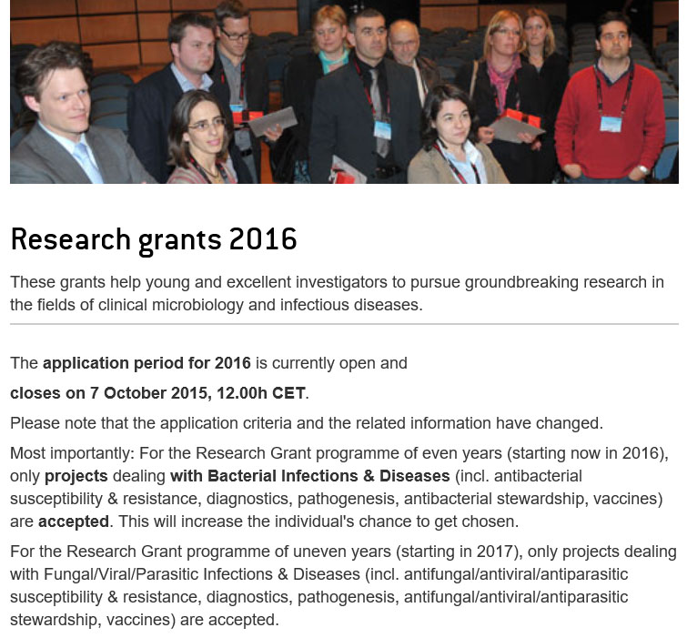
Research Grants 2016

Slide 27
Research Grants 2016

Slide 28
ESCMID Observerships

Slide 29
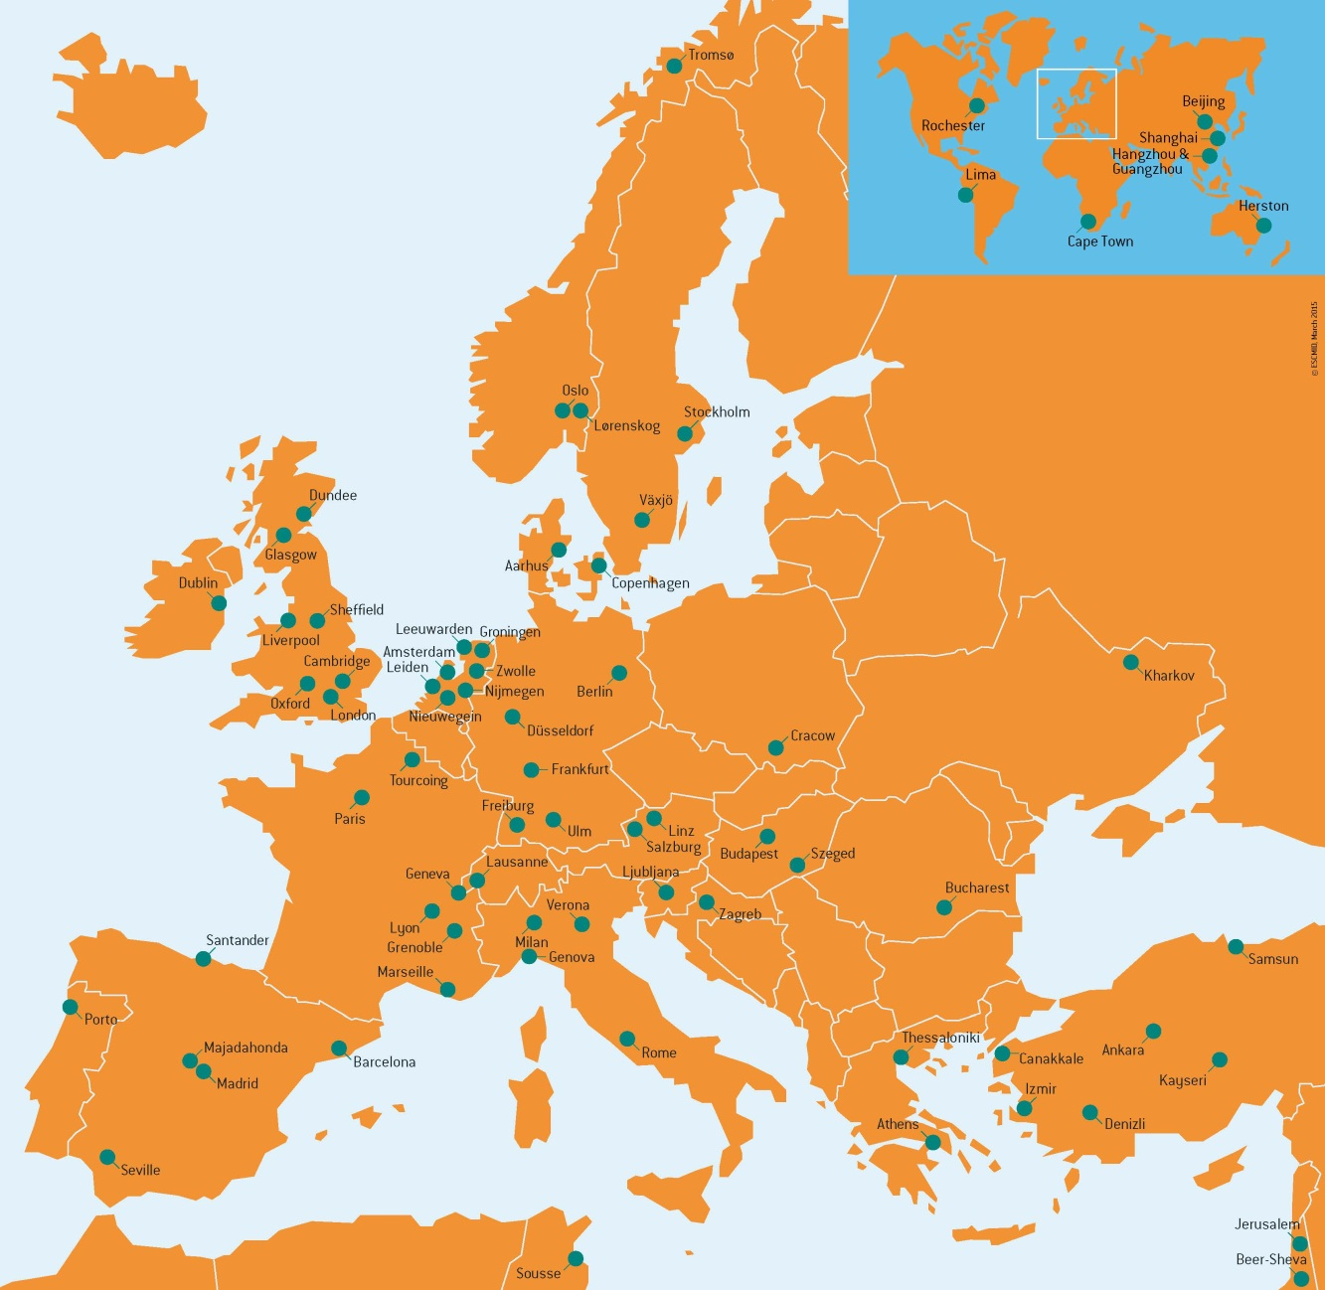
ESCMID Collaborative Centres
81 fully approved ECCs
14 new ECCs in 2014/2015

Slide 30
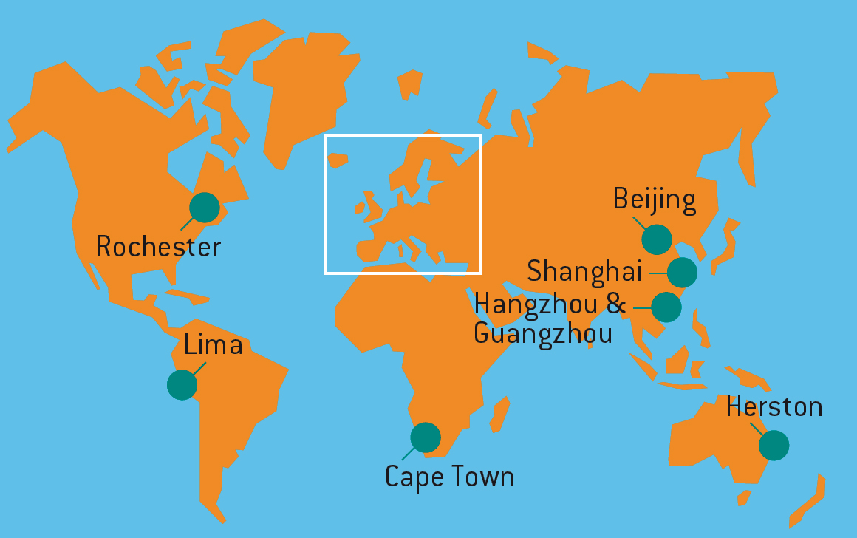
ESCMID Collaborative Centres

Slide 31
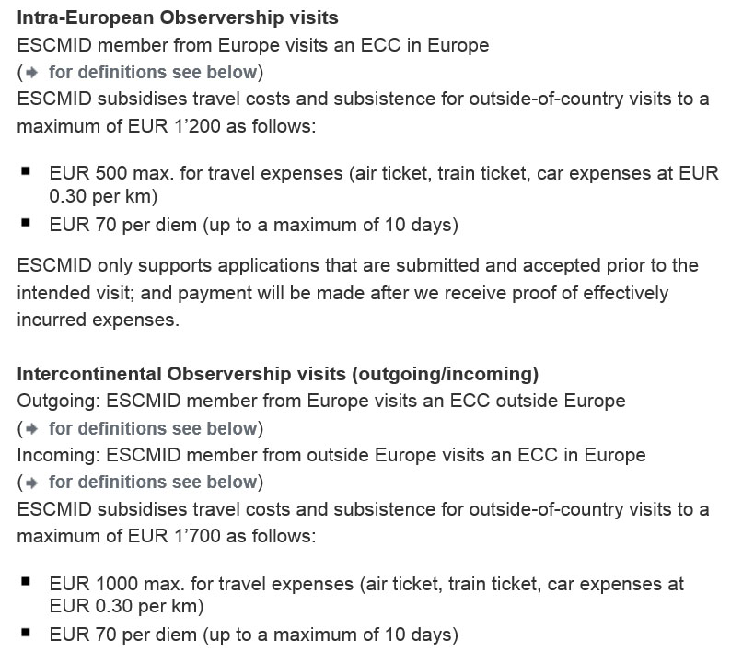

Slide 32
Rating of Observership visits

Slide 33
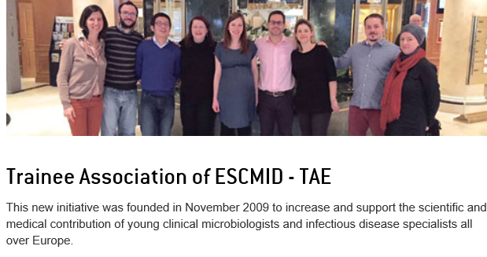

Slide 34
EUCAST – The European Committee on Antimicrobial Susceptibility Testing A joint venture between ESCMID, ECDC and the national breakpoint committees in Europe (BSAC, CA-SFM, CRG, DIN, NWGA and SRGA). EMA breakpoint committee EFSA AMR surveillance based on EUCAST ECOFFs

Slide 35
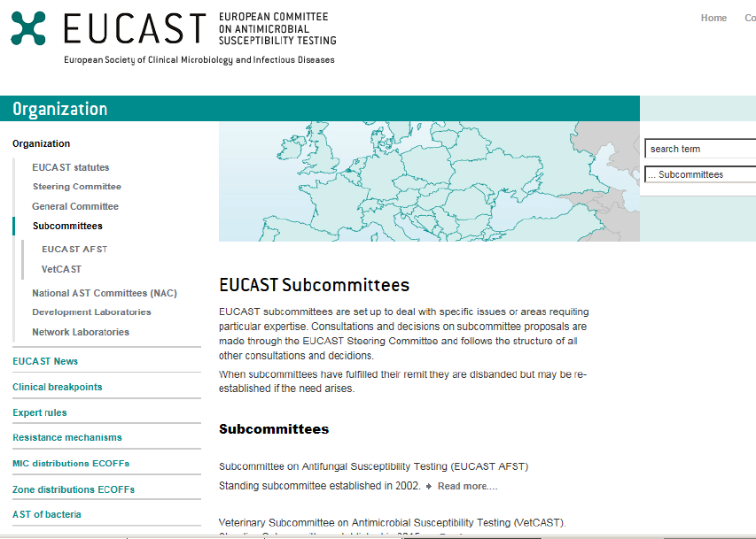
EUCAST
EUCAST Chairpersons
Ian Philips, GB 1997 – 2001
Gunnar Kahlmeter, S 2001 – 2012
Rafael Canton, ES 2012 – 2016
Christian Giske, S 2016 - ?

Slide 36
Implementation of EUCAST breakpoints, Late 2015
% Laboratories
>50%
Finland
10-50%
Norway
<10%
Sweden
Estonia
Russia
No information
Latvia
Denmark
Lithuania
Ireland
Belarus
Great Britain
Nether- lands
Poland
Germany
Ukraine
Belgium
Luxembourg
Czech
Republic
Slovakia
Moldova
France
Switzer- land
Austria
Hungary
Romania
Georgia
Azerbaijan
Slovenia
Armenia
Croatia
Bosnia-
Herze- govina
Serbia
Monte- negro
Kosovo
Bulgaria
Portugal
Italy
Mace-
donia
Turkey
Spain
Albania
Greece
Malta
Countries not on this map:
Australia
Brazil
Iceland
Israel
Morocco
New Zealand
South Africa

Slide 37
Euro Surveillance 2015;20:pii=21008
Uptake of EUCAST guidelines by participants in UKNEQAS (updated)
(630-750 participants per year from a total of 40 countries)

Slide 38
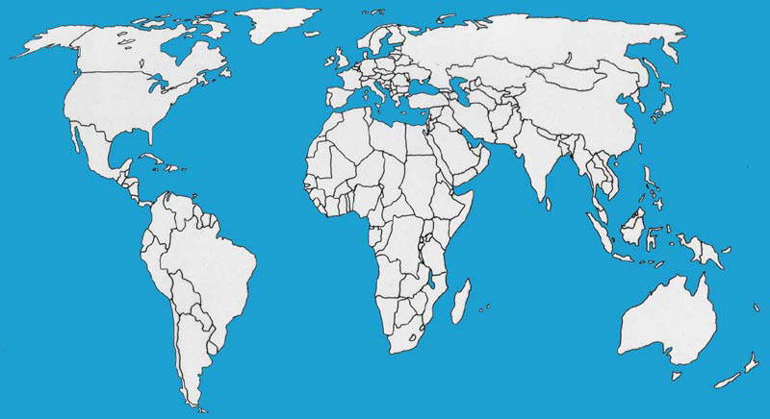
National Antimicrobial Committees (NACs)
Status April 2015
Countries with a NAC operating under EUCAST standards
Countries with interest to establish a NAC under EUCAST standards

Slide 39
Disk diffusion
In the “old days”
NCCLS - USA
SRGA - Sweden
BSAC – The UK
CA-SFM - France
(DIN) - Germany
(NL) - Netherlands
Nowadays
EUCAST
CLSI
J Antimicrob Chemother. 2015 Sep 16. pii: dkv287. [Epub ahead of print]
Antimicrobial susceptibility testing breakpoints and methods from BSAC to EUCAST.
Brown DF¹, Wootton M², Howe RA².
Abstract
…. and BSAC will replace support of its own disc diffusion method with support for the EUCAST method from January 2016.

Slide 40
Open consultations October 2015
Nitroxoline breakpoints
Modified definition of the I-category
Expected consultations 2016
Revision of tigecycline breakpoints
Revision of fluoroquinolone breakpoints
Review/revision of carbapenem breakpoints
SOP 10 (What to do when breakpoints are lacking?)
Intrinsic resistance and expert rules (revision)

Slide 41
EUCAST Pipeline
Colistin breakpoints
Nitroxoline breakpoints
Temocillin breakpoints
Revisions of tigecycline, fluoroquinolones
Several new antimicrobials – breakpoints
Several new species (breakpoints and methods)
Breakpoints for rapid (8h) phenotypic AST
Revised definition of the intermediate category

Slide 43
CMI Impact Factor Evolution 2008-2014
2008 | 2009 | 2010 | 2011 | 2012 | 2013 | 2014
3.554 | 4.014 | 4.784 | 4.540 | 4.578 | 5.197 | 5.768
*

